Slide 1
Game Theory
Day 9

Slide 2
Non- Zero Sum Games How to solve?
3 Solution Methods for Non-Zero Sum Games
Dominant Strategy
Iterated Dominant Strategy
Nash Equilibrium
International Trade!

Slide 3
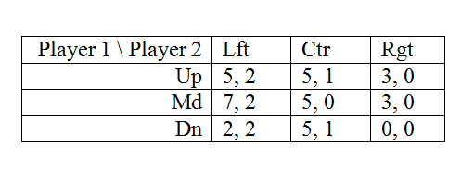
Method 1: Dominant Strategy Solution
Non-zero sum game
2 player, 3 strategy
Dominant Strategy Solution is (Md, Ctr)
Strong or weak dominance?

Slide 4
Method 2: Iterated Dominance
Recall the homework problem for zero-sum game where we found dominance over and over again.
We can do the same with a non-zero sum game.
To keep vocab straight:
Dominated strategy -- Bad
Undominated strategy -- Good
Dominant strategy -- Best

Slide 5
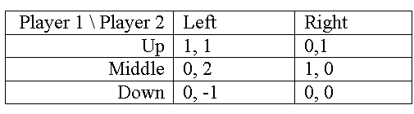
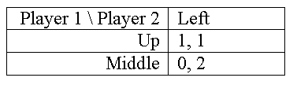
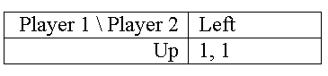
Iterated Dominance Example
Rewrite the game:
Consider player 1 again: which strategy is dominated?
Rewrite for solution:
Consider player 1: Which strategy is dominated?
Rewrite the game:
Consider player 2: Which strategy is dominated?

Slide 6
Method 3: Nash Equilibrium
Nash Equilibrium is a term used in game theory to describe an equilibrium where each player's strategy is optimal given the strategies of all other players. A Nash Equilibrium exists when there is no unilateral profitable deviation from any of the players involved. In other words, no player in the game would take a different action as long as every other player remains the same. Nash Equilibria are self-enforcing; when players are at a Nash Equilibrium they have no desire to move because they will be worse off.

Slide 7
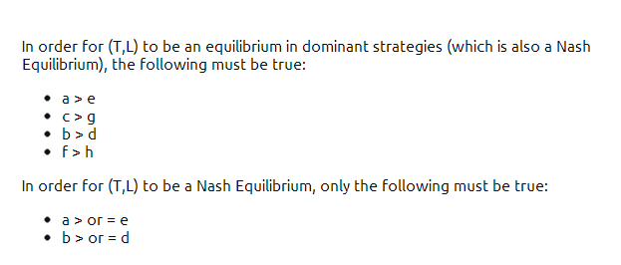
Nash Equilibrium vs. Dominance Strategy
Consider the following payoff matrix:

Slide 8
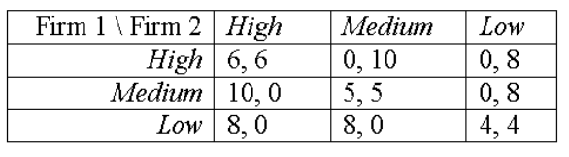
Example. Price Competition
Duopoly: When two companies share exclusively the market for a certain product.
How can a company set their prices in order to receive maximum profit?
Compare NE (Nash equilibrium) to IDS (iterated dominance strategy)

