Slide 1
Game Theory
Day 4

Slide 2
Dominant Strategy
Definition: Strategy s’_{i} strongly dominates all other strategies of player i if the payoff to s’_{i} is strictly greater than the payoff to any other strategy, regardless of which strategy is chosen by the other player(s)
Let us consider player 1 and player 2 with strategies a and b.
π₁(s₁^{b},s₂ª) > π₁(s₁ª,s₂ª)
π₁(s₁^{b},s₂^{b}) > π₁(s₁ª,s₂^{b})
This would be interpreted as strategy b is strongly dominate over strategy a for player 1. Thus strategy a is the dominated strategy.

Slide 3
(Weakly) Dominant Strategy
Definition: Strategy s’_{i} weakly dominates another strategy of player i if the payoff to s’_{I} does at least as well as the payoff to any other strategy, regardless of which strategy is chosen by the other player(s)
Let us consider player 1 and player 2 with strategies a and b.
π₁(s₁^{b},s₂ª) > π₁(s₁ª,s₂ª)
π₁(s₁^{b},s₂^{b}) > π₁(s₁ª,s₂^{b})
This would be interpreted as strategy b is weakly dominate over strategy a for player 1.

Slide 4
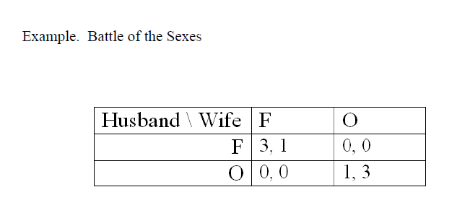
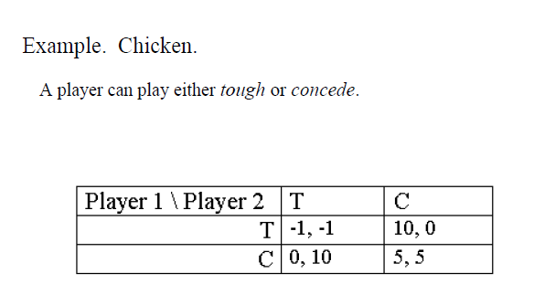
Which are dominant strategy games?

Slide 5
Zero-Sum Games
Definition: In a two-player (ONLY) game, the payoffs of player 2 are just the negative of the payoffs of player 1.
The incentives of the two players are diametrically opposed (i.e. one player wins if and only if the other loses)
Player 1’s worst possibility is also player 2’s best
Ex. Card games, chess, one-on-one basketball, etc…

Slide 6
Constant-sum Game
Definition: the payoffs of the two players always add up to a constant, say b, no matter what strategy vector is player.
π₁(s₁,s₂) + π₂(s₁,s₂) = b
Example: Squash (next slide)
We can consider a constant-sum game if you subtract the sum from the lowest payoff in each case.

Slide 7
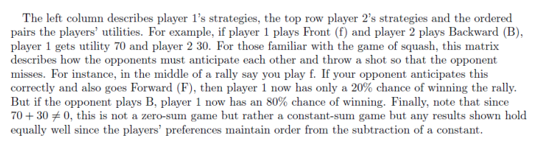
Squash
1\2 | Forward (F) | Backward (B)
Front (f) | 20, 80 | 70, 30
Back (b) | 90, 10 | 30, 70

Slide 8
Matrix Game
Notice for a Zero-Sum game, only one set of payoffs need be listed.
Domination
Compare rows and columns
Saddle Point
If the entry at the outcome is both less than or equal to any entry in its row and greater than or equal to any entry in its column (matrix game with payoffs to row player)
Rose\Colin | A | B | C | D
A | 4 | 2 | 5 | 2
B | 2 | 1 | -1 | -20
C | 3 | 2 | 4 | 2
D | -16 | 0 | 16 | 1
Dominance Principle:
A rational player should never play a dominated strategy
Saddle Point Principle:
If a matrix game has a saddle point, both players should play a strategy which contains it.

