Slide 1
Game Theory
Day 3

Slide 2
Strategic Form Games
The strategic form of a game is specified by three objects
The list of players in the game
The set of strategies available to each player
The payoffs associated with any strategy combination (one strategy per player)
Example: 2x2 array of payoffs
Player 1\2 | Confess | Does Not Confess
Confess | -5, -5 | 0, -15
Does Not Confess | -15, 0 | -1, -1

Slide 3
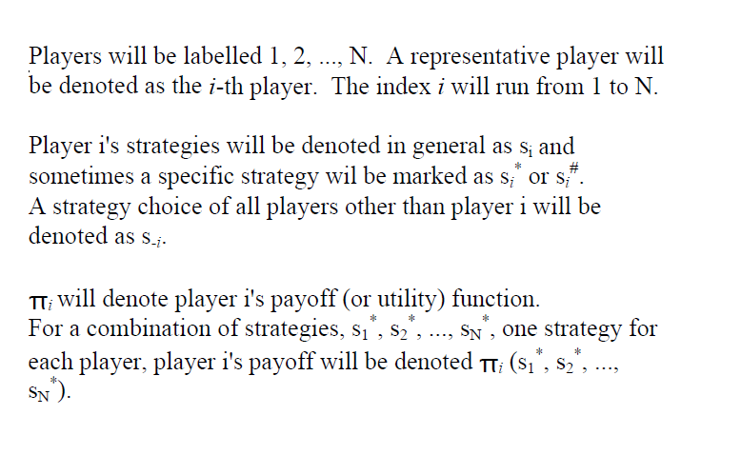
Mathematical Notation

Slide 4
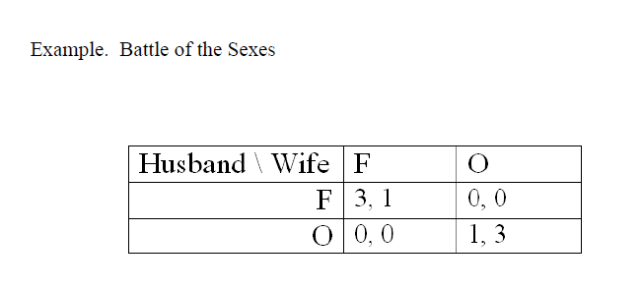
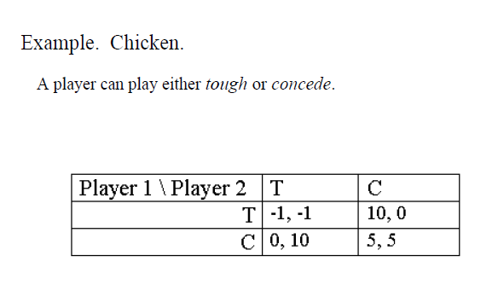
Examples
Battle of the Sexes
A husband and wife are trying to determine whether to go to the opera or to a football game. They each respectively, prefer the football game and the opera. At the same time each of them would rather go with the spouse than go alone.

Slide 5
Dominant Strategy Solution
Recall Prisoners’ Dilemma
Player 1\2 | Confess | Does Not Confess
Confess | -5, -5 | 0, -15
Does Not Confess | -15, 0 | -1, -1

Slide 6
Dominant Strategy
Definition: Strategy s’_{i} strongly dominates all other strategies of player i if the payoff to s’_{i} is strictly greater than the payoff to any other strategy, regardless of which strategy is chosen by the other player(s)
Let us consider player 1 and player 2 with strategies a and b.
π₁(s₁^{b},s₂ª) > π₁(s₁ª,s₂ª)
π₁(s₁^{b},s₂^{b}) > π₁(s₁ª,s₂^{b})
This would be interpreted as strategy b is strongly dominate over strategy a for player 1.

Slide 7
(Weakly) Dominant Strategy
Definition: Strategy s’_{i} weakly dominates another strategy of player i if the payoff to s’_{I} does at least as well as the payoff to any other strategy, regardless of which strategy is chosen by the other player(s)
Let us consider player 1 and player 2 with strategies a and b.
π₁(s₁^{b},s₂ª) > π₁(s₁ª,s₂ª)
π₁(s₁^{b},s₂^{b}) > π₁(s₁ª,s₂^{b})
This would be interpreted as strategy b is weakly dominate over strategy a for player 1.

Slide 8
Which are dominant strategy games?

