Slide 1
Game Theory
Day 2: More Simple Games

Slide 2
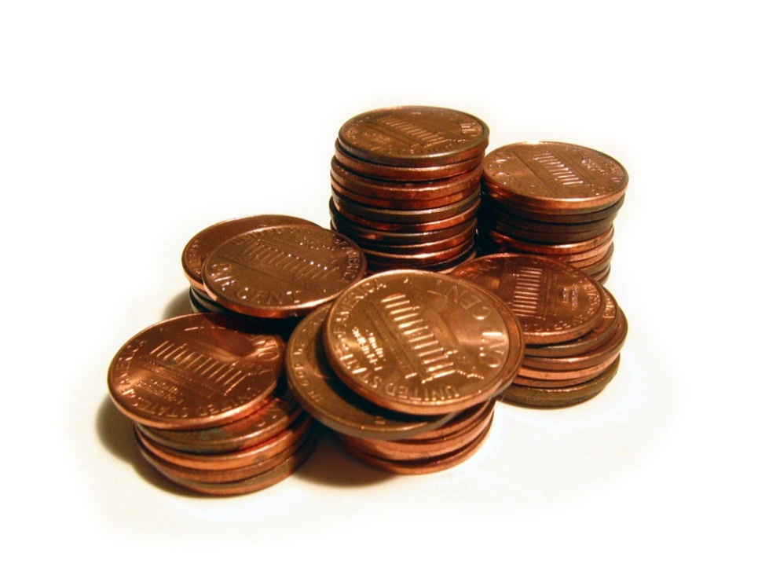
Let’s play a game
Consider the following two-person game.
There are initially some number of pennies on the table.
During a move a player can remove either one, two, or three pennies.
The player who takes the last stone wins.
Strategy:
It is clear that if there are only one, two, or three stones left (on your turn), you can win the game by taking all of them. If, however, there are exactly four stones you will lose, because no matter how many you take, you will leave one, two, or three and your opponent will win by taking the remainder. If there are five, six, or seven stones you can win by taking just enough to leave four stones. If there are eight stones you will again lose, because you must leave five, six, or seven. Etc.

Slide 3
Nim and Marienbad
Two piles of matches/stones
Two players take turns removing any number of matches from either pile
Can only remove matches from one pile
Nim: Player who removes the last match wins the game.
Marienbad: Player who removes the last match loses the game.
Monkey Nim Game

Slide 4
Voting
A voter thinks through what the other voters are likely to vote rather than voting simply according to his preferences.
Scenario: There are two competing bills, A and B, and three voters 1, 2, and 3.
Outcomes: Either A or B will passed or neither (status quo)
Voting Process: Vote on A or B, then Vote winner or neither (N)
Voter Preferences
A > B is “Bill A is preferred to Bill B”
Voter 1: A > N > B
Voter 2: B > A > N
Voter 3: N > A > B

Slide 5
Truthful Voting
Round 1
Voter 1: A
Voter 2: B
Voter 3: A
THUS, A passes
Round 2
Voter 1: A
Voter 2: A
Voter 3: N
A would pass!
Voter Preferences
A > B is “Bill A is preferred to Bill B”
Voter 1: A > N > B
Voter 2: B > A > N
Voter 3: N > A > B

Slide 6
Tactical Voting What could voter 3 do to change the outcome?
Round 1
Voter 1: A
Voter 2: B
Voter 3: B
THUS, B passes
Round 2
Voter 1: N
Voter 2: B
Voter 3: N
Neither wins!
Voter Preferences
A > B is “Bill A is preferred to Bill B”
Voter 1: A > N > B
Voter 2: B > A > N
Voter 3: N > A > B

Slide 7
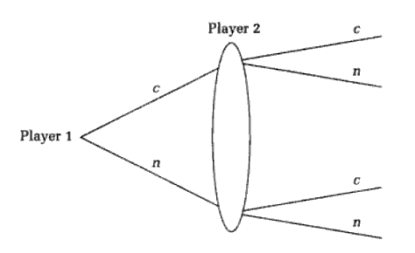
How can we formalize a game’s explanation?
Extensive form: A pictorial representation of the rules. It uses a game tree which is made up of a root and branches in order.
Information Set: A collection of decision nodes that a player cannot distinguish between (Oval).
Simultaneous movement: the case when both players move at the same time or when one player moves after another without knowledge of the other player's movements.
Prisoners’ Dilemma

Slide 8
Prisoners’ Dilemma Continued…
Utility Payoff: The numerical result of a decision.
Suppose we write a prison term of 5 years as a utility payoff of -5, and so on.
-5, -5
0, -15
-15, 0
-1, -1

