Slide 1
“No Man is an Island”
Game Theory:
A study of interdependence and the strategy of games

Slide 2
Interlinked Situations
What will each individual guess about the others’ choices?
What action will each person take?
What is the outcome of these actions? Is this outcome good for the group as a whole?
Does it make any difference if the group interacts more than once?
How do the answers change if each individual is unsure about the characteristics of others in the group?

Slide 3
Real-World Interdependence
Art Auctions
Voting
Natural Resources and sustainability
Random drug testing
Bankruptcy law
Trench warfare in WWI
Group projects

Slide 4
Formal Definition
Game Theory: A formal way to consider each item –
Group: In any game there is more than one decision-maker; each decision maker is referred to as a “player”
Interaction: What any one individual player does directly affects at least one other player in the group
Strategic: An individual player accounts for this interdependence in deciding what action to take
Rational: While accounting for this interdependence, each player chooses her best action

Slide 5
Examples
Group Project
Drug Testing
The group comprises the students jointly working on the case.
The interaction arises from the fact that certain amount of work needs to get done .
Strategic play involves estimating the likelihood of freeloaders in the group
Rational play requires a careful comparison of the benefits to a better grade against the costs of extra work.
The group is made up of the students/athletes and those giving the test
The interaction is both between the players in the group.
Rational strategic play requires the student/athletes to make decisions based on their chances of getting caught, as well as punishment, cost of test, and value of reputation.

Slide 6
When is it NOT a game?
ONE VS.
INFINITY
Context where your decision affect no one but yourself
Examples?
Situations where your decisions do affect others, but there are so many people involved that it is neither feasible nor sensible to keep track of what each one does.
Examples?

Slide 7
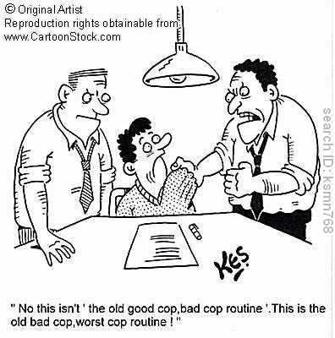
Prisoner’s Dilemma
“Granddaddy” of simple games
Scenario: Two people are questioned suspected of a crime. Offered a deal, to confess or not confess?
Prisoner A, B | Confess | Not Confess
Confess | 5, 5 | 0, 15
Not Confess | 15, 0 | 1, 1

Slide 8
Prisoner’s Dilemma Cont…
Dilbert Silly Example
Dark Knight: Social Experiment

Slide 9
Homework
Game Theory Day 1 Worksheet

